Slide 1
If and Conditional Statements
By: 李家宏 D1050961

Slide 2
Conditional Statement
A == B Equality
A != B Inequality
A < B Less than
A <= B Less than or equal to
A > B Greater than
A >= B Greater than or equal to

Slide 3
If Statement
Use the if statement with the conditional statement :
"if one condition applies, do this;
elif a different condition applies, do something different.”
You can chain as many elifs as you want.
At the end, put an else block when all other conditions don’t apply.
The chain would be like: If -> Else If -> Else

Slide 4
Additional supplement
You can also check whether an element is in a list or not:
Taiwan in Country (True)
Taiwan not in Country (False)
But to China… It might be the opposite of the answer above.

Slide 5
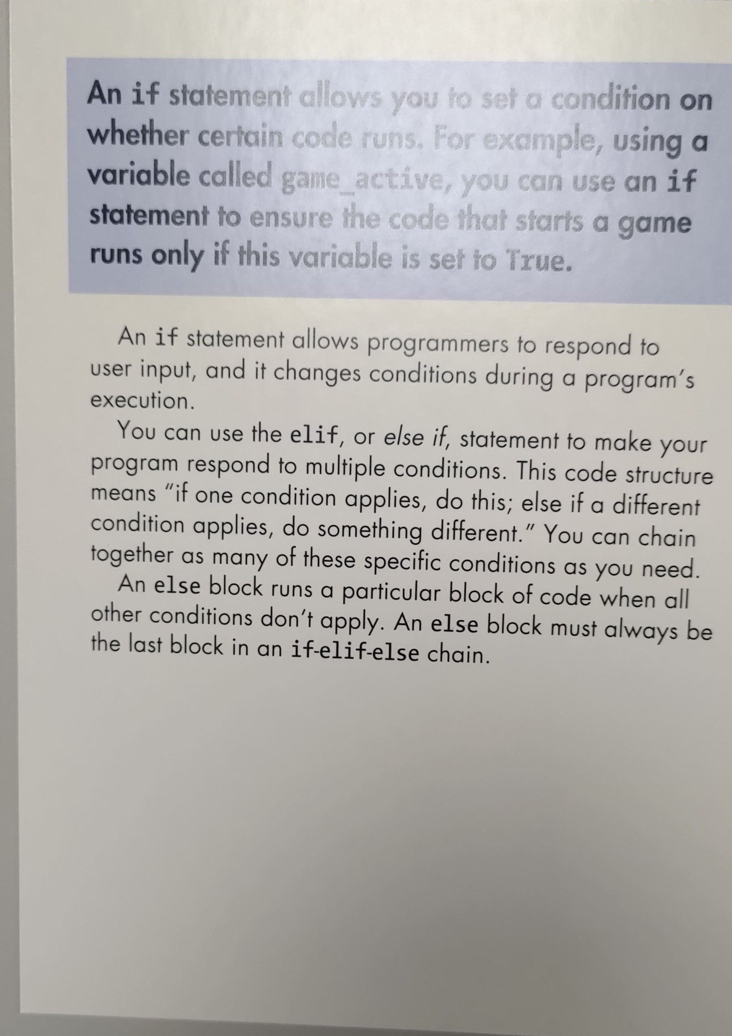
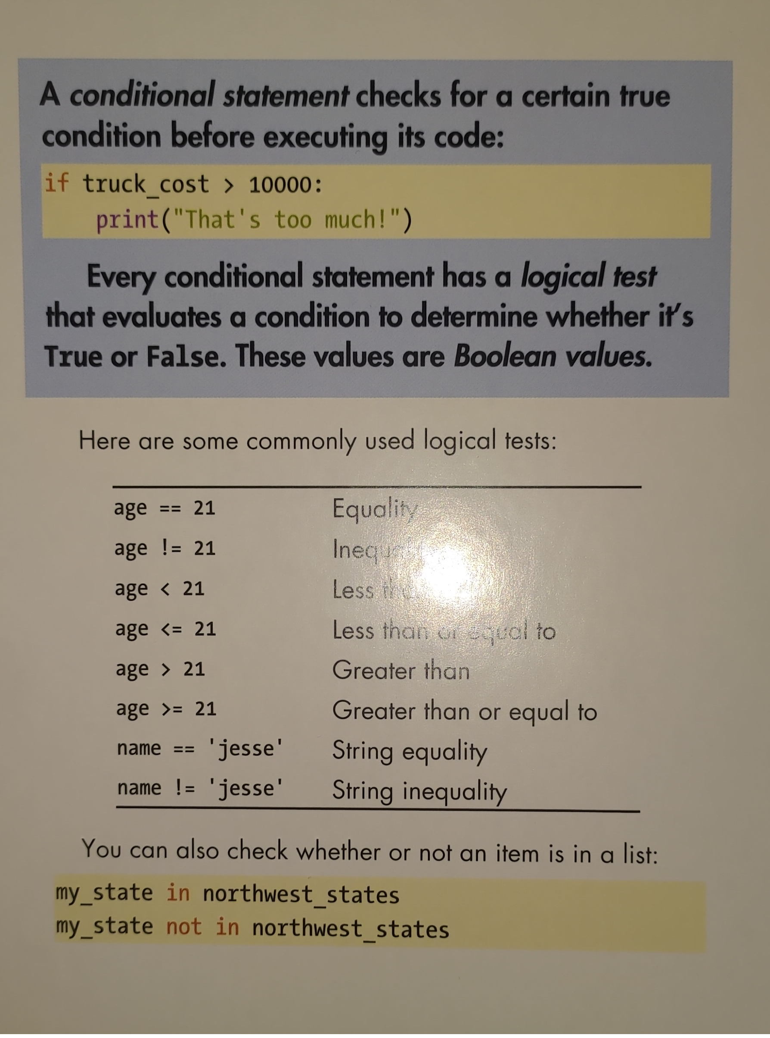
The two cards I presented
P.S. I forgot to film the front of the card...

